Slide 1
Risk Analysis and Assessment

Slide 2
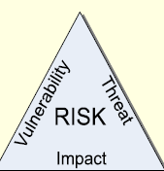
Risk
What is risk?
  “The possibility of suffering loss”.
It is the potential for realizing unwanted negative consequences of an event.
A risk is a probability that some adverse circumstance will occur .
  Not inherently bad, Essential to progress!.
  The challenge is to manage the amount of risk.
Risk is a function of: Threats, vulnerabilities, and impact
[Risk = Threats x Vulnerabilities x Impact] …..
  Against assets.

Slide 3
Assets, Threats, Vulnerabilities and impacts
Assets: Anything of value such as people, information, hardware, software, facilities, reputation, activities, and operations
Threat: An indication of a potential undesirable event.
Examples: Hackers, Insiders, ..etc
Vulnerability: Any weakness (in a system, control, or countermeasure) that can be exploited by an adversary.
Examples: Networks, operating Systems, Application, People, or Processes.
An impact: Refers to the degree of likely harm incurred should a vulnerability be exploited such as strategic, financial, or legal consequences.

Slide 4
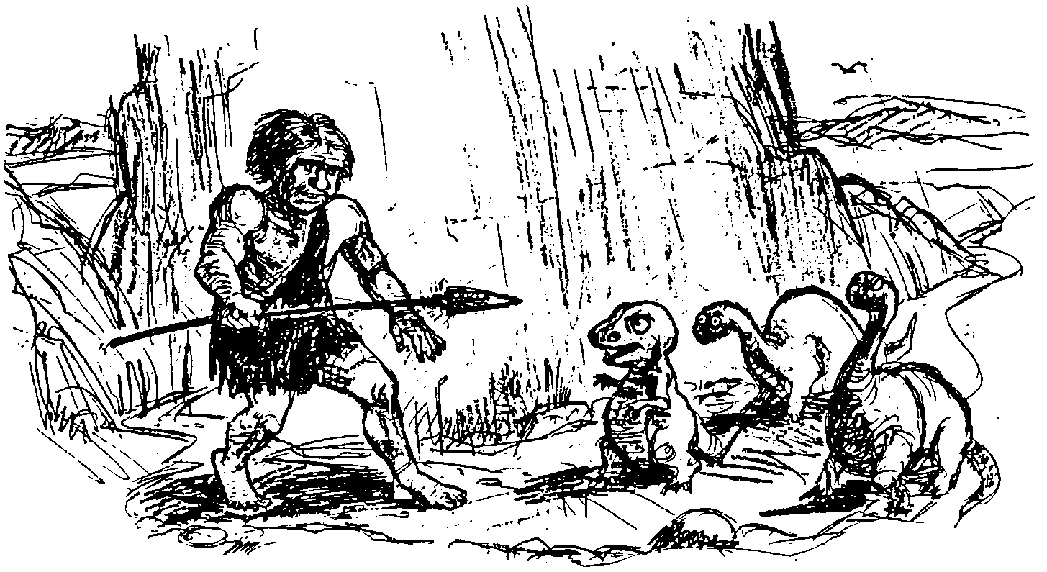
If you don’t actively attack the risks...

Slide 5
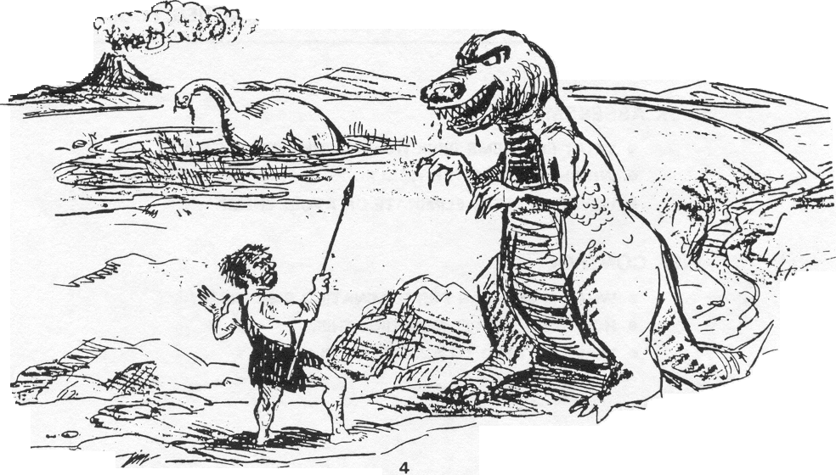
...the risks will actively attack you –Tom Gilb

Slide 6
Risk management
Risk management is concerned with identifying risks and drawing up plans to minimise their effect on a project.
Systematic and analytical process by which an organization identifies, reduces, and controls its potential risks and losses.
Project risks affect schedule or resources;
Product risks affect the quality or performance of the software being developed;
Business risks affect the organisation developing or procuring the software.

Slide 7
Risk Management
General idea:
  Identify your project’s risks
  Assess their impact and likelihood
  Prepare plans to mitigate or avert them
  Monitor the risks and their corresponding plans

Slide 8
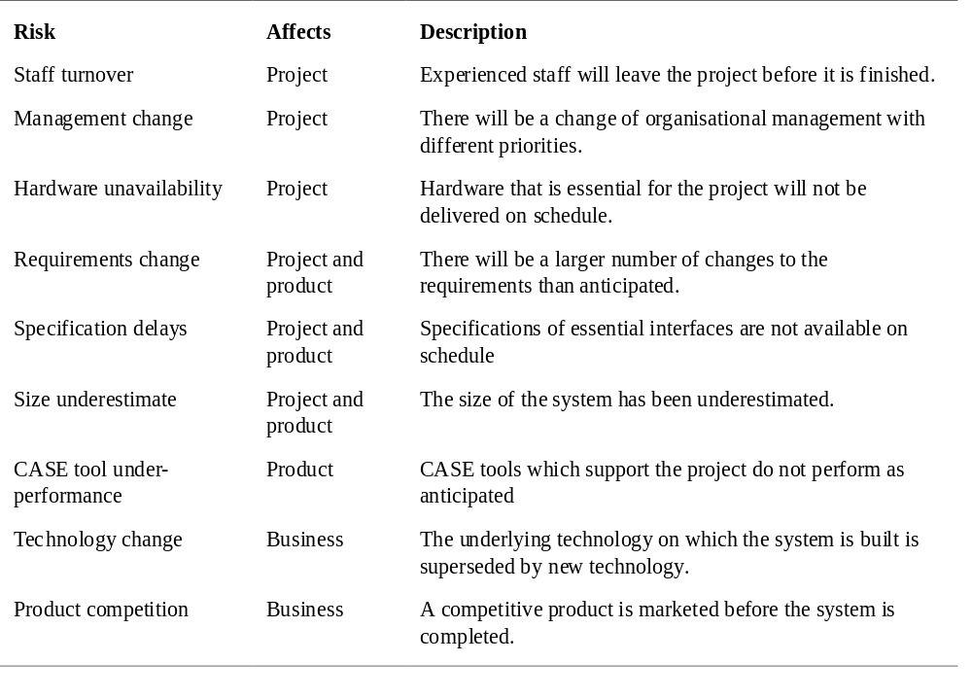
Software risks

Slide 9
The risk management process
Risk identification
  Identify project, product and business risks;
Risk analysis
  Assess the likelihood and consequences of these risks;
Risk planning
  Draw up plans to avoid or minimise the effects of the risk;
Risk monitoring
  Monitor the risks throughout the project;

Slide 10
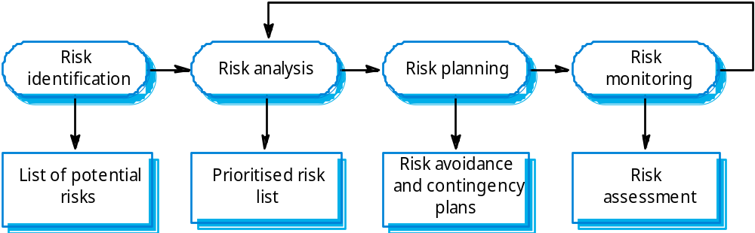
The risk management process

Slide 11
Risk identification
Technology risks.
People risks.
Organisational risks.
Requirements risks.
Estimation risks.

Slide 12
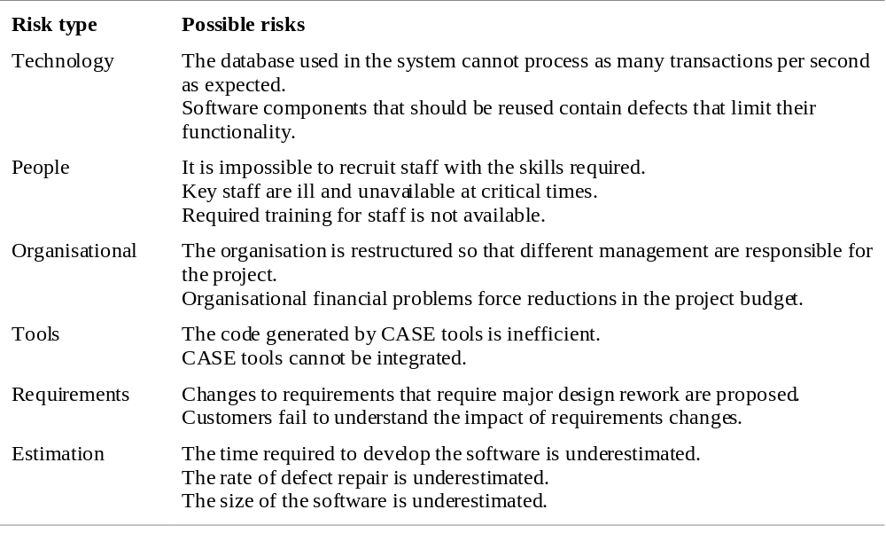
Risks and risk types

Slide 13
Risk assessment
Can be very time consuming
Produces plans that can seem overwhelming
Begs the question of what to do now

Slide 14
Risk Identification: Checklists
(Boehm’s Top 10 Risks)
Personnel shortfalls
  Staff with top talent
  Job matching
  Team building
  Key personnel agreements
  Cross training
Unrealistic schedules and budgets
  Multisource estimation
  Incremental development
Developing the wrong features
  Requirements analysis
  Prototyping
Developing the wrong user interface
  Prototyping, user participation
Gold-plating
  Cost-benefit analysis
  Designing to cost
Continuing stream of requirements changes
  High change threshold
  Deferring changes to later increments
Shortfalls in external components
  Benchmarks
  Inspections
Shortfalls in external tasks
  Pre-award audits
  Award-fee contracts
Real-time performance shortfalls
  Simulations
  Prototyping
Straining computer science capabilities
  Technical analysis
  Cost-benefit analysis
  Prototyping

Slide 15
Principles of
Risk Management
Global Perspective
  View software in context of a larger system
Forward Looking View
  Anticipate possible outcomes
  Identify uncertainty
  Manage resources accordingly
Open Communications
  Free-flowing information at all project levels
  Value the individual voice
    Unique knowledge and insights
Integrated Management
  Project management is risk management!
Continuous Process
  Continually identify and manage risks
Shared Product Vision
  Everybody understands the mission (shared ownership)
Teamwork
  Work cooperatively to achieve the common goal
  Pool talent, skills and knowledge

